Slide 1
Day 2

Slide 2
Selector types
Element selector
body { font-size: 16px; }
Class selector .class-name { Background-color: #00ff00; }
Attribute selector [attribute-name=”value”] { width: 100vw; }
ID selector #id-name { width: 100vw; }

Slide 3
Combining selectors
body.class-name { font-size: 16px; }
body#id-name { font-size: 16px; }
#main-header .head-title { font-size: 16px; }
#main-header, div, h1 { font-size: 16px; }
.header-title + p { font-size: 16px; }
div > p { font-size: 16px; }
ul li { font-size: 16px; }

Slide 4
Pseudo selectors
a:hover { color: black; background-color: yellow; }
a:active {
color: white;
background-color: blue;
}
a:visited {
background-color: gray;
}
h1:before,
h1:after {
display: block;
width: 10px;
height: 10px;
}
li:nth-child(number, odd, even) {
background-color: #cccccc
}

Slide 5
Use semantic names for classes, not descriptive ones

Slide 6
<h1 class=”page-title”> This is good class name </h1> <p class=”blue-text”> Worst class name, like eva’! </p>

Slide 7
Types of HTML elements
Block
Inline
Inline-block
But you can easily change those with display property

Slide 8
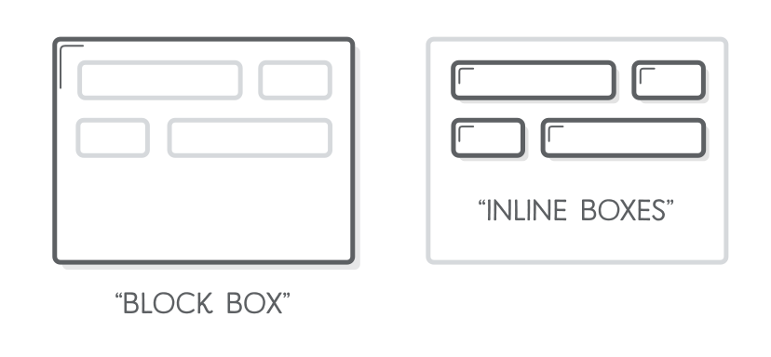

Slide 9
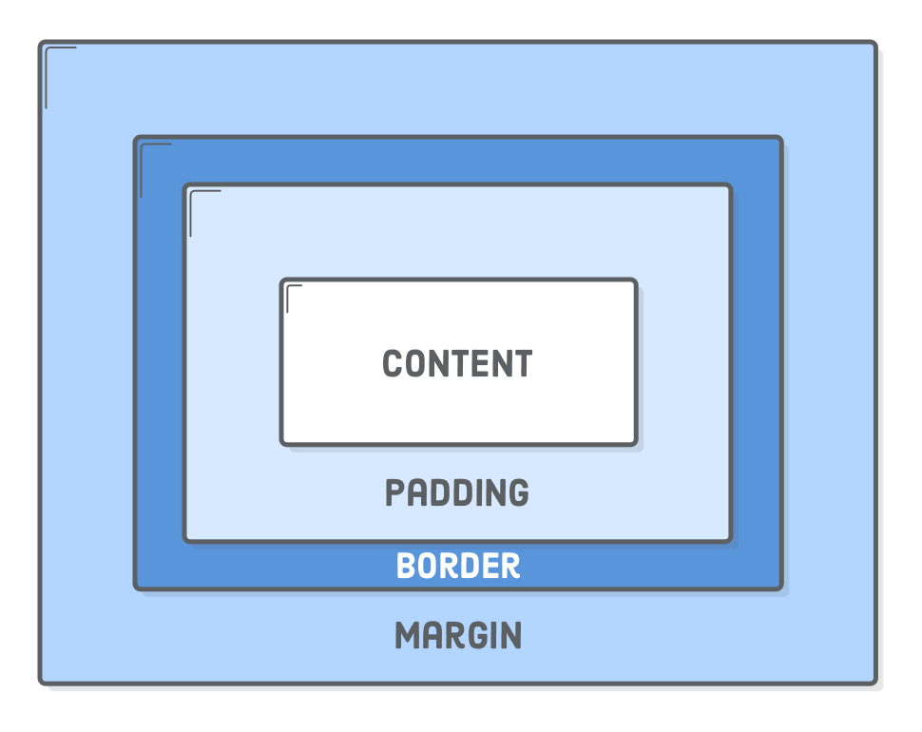
Box model

Slide 10
div { width: 300px; border: 25px solid green; padding: 25px; margin: 25px; }

Slide 11
Block boxes always appear below the previous block element. This is the “natural” or “static” flow of an HTML document when it gets rendered by a web browser.
The width of block boxes is set automatically based on the width of its parent container. In this case, our blocks are always the width of the browser window.
The default height of block boxes is based on the content it contains. When you narrow the browser window, the <h1> gets split over two lines, and its height adjusts accordingly.
Inline boxes don’t affect vertical spacing. They’re not for determining layout—they’re for styling stuff inside of a block.
The width of inline boxes is based on the content it contains, not the width of the parent element.

Slide 12
Page layout basics
<header> <h1>Main Page Title</h1> </header> <main> <p>Main content goes here</p> </main> <aside> <p>Additional related content goes here</p> </aside> <footer> <p>Copyright text &copy;</p> </footer>

Slide 13
Flexbox basics
body { display: flex; flex-wrap: wrap; } body > header, body > footer { width: 100%; flex-grow: 1; } body > main { flex-grow: 1; max-width: 75%; } body > aside { width: 300px }

Slide 14
The awesomeness of flexbox
body { display: flex; flex-wrap: wrap; flex-direction: row; align-items: stretch; justify-content: space-around; } body > main { order: -1; }

Slide 15
Holy Grail of layout - CSS Grid
body { display: grid; grid-template-columns: 1fr 33%; grid-template-rows: auto; grid-column-gap: 20px; grid-row-gap: 30px; grid-template-areas: "header header" "main sidebar" "footer footer"; } header { grid-area: header; } footer { grid-area: footer; }

Slide 16
Resources

Slide 17
www.csswizardry.com
www.smashingmagazine.com
www.alistapart.com
https://code.tutsplus.com/tutorials/the-30-css-selectors-you-must-memorize--net-16048
https://medium.freecodecamp.org/its-not-dark-magic-pulling-back-the-curtains-from-your-stylesheets-c8d677fa21b2
https://css-tricks.com/snippets/css/a-guide-to-flexbox/
https://css-tricks.com/css-is-awesome/
https://www.smashingmagazine.com/2018/05/guide-css-layout/
https://www.smashingmagazine.com/2018/10/flexbox-use-cases/

